Slide 1
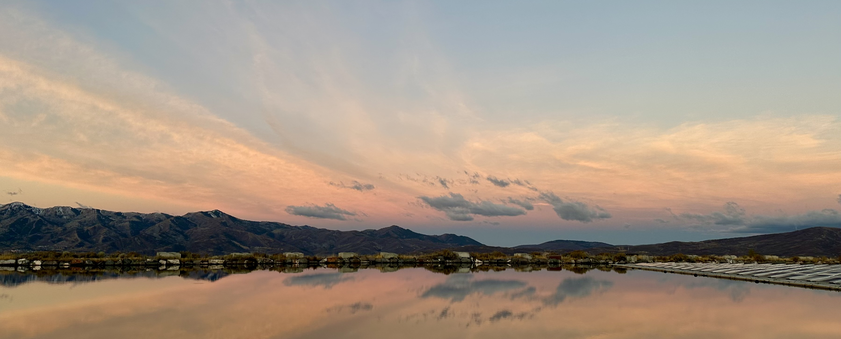

Asset Management Update
MRW ACB Meeting
September 17, 2026

Slide 2

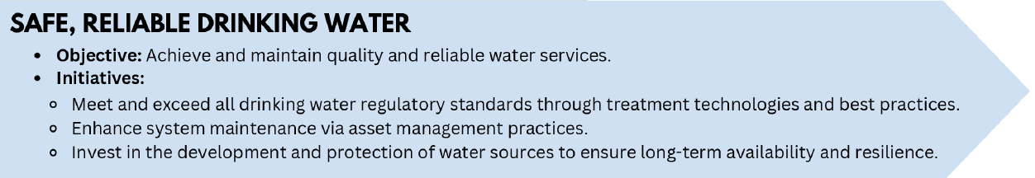
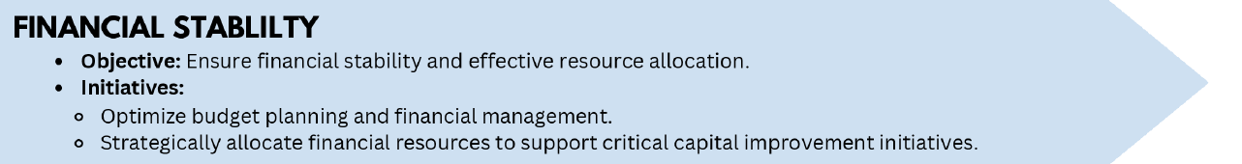
Asset Management Goals
Maintain reliable water service through proactive maintenance.
Organize asset information and maintenance history in one accessible system.
Prioritize repair and replacement based on condition and criticality.
Improve long-term capital planning and budgeting.

Slide 3
Terminology
OpenGov
The software MRW is using for Asset Management
Horizontal assets
Infrastructure that spans a wide geographic area or equipment not contained within a building
Example: water mains, meter pits, hydrants, etc.
Vertical assets
Equipment contained within a distinct geographic footprint
Example: pumps, motors, valves, etc. within a facility

Slide 4
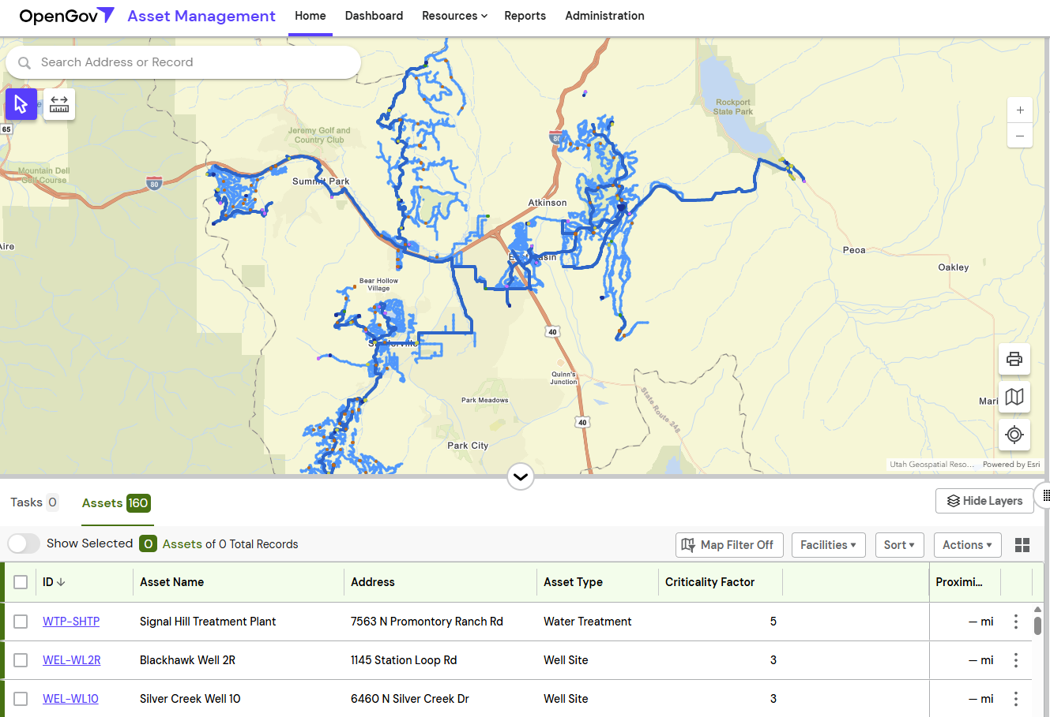
Current Status
All horizontal assets are entered into OpenGov; staff continue filling gaps in asset information.
Facility criticality scoring complete.
Most departments actively use OpenGov for day-to-day tasks.
Digital workflows are replacing paper work orders and automating routine steps.

Slide 5
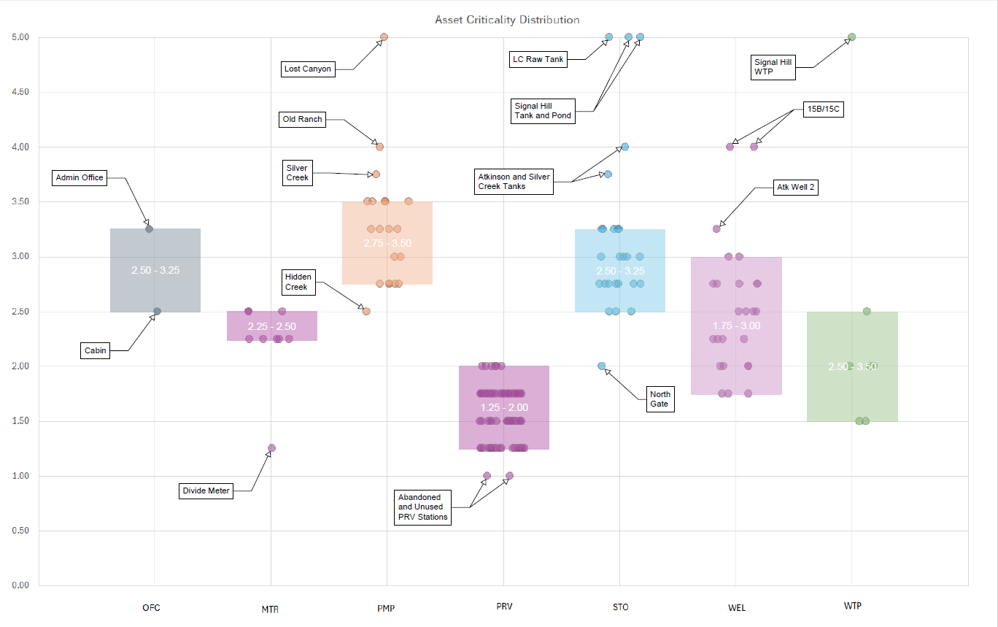
  Criticality measures the consequence of a facility failure.
  Higher scores indicate greater impact.

Slide 6
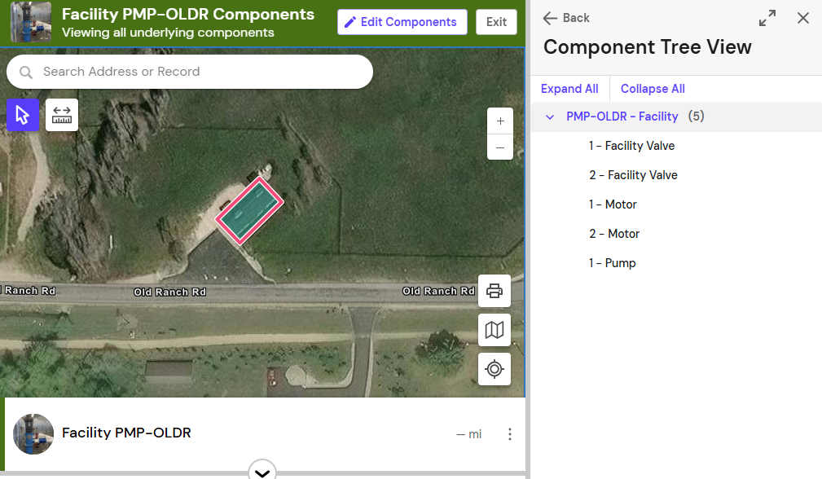
Remaining 2026 Goals
Complete planned asset records and equipment inventories.
Finalize digital workflows and expand labor, equipment, and material cost tracking.
Implement preventive maintenance tasks for vehicles and equipment.
Develop condition scoring criteria and finalize performance measures.
Develop staff training materials and a training plan.

Slide 7
2027 Goals
First Half of 2027
Complete initial asset condition assessments.
Introduce dashboards for managers and staff.
Begin meter and endpoint inventory tracking.
Develop a fleet replacement strategy and metrics.
Second Half of 2027
Develop an asset replacement strategy.
Establish a facility log.
Use asset information to support capital project planning.

Slide 8
Demo

Slide 9
Questions?

