Slide 1
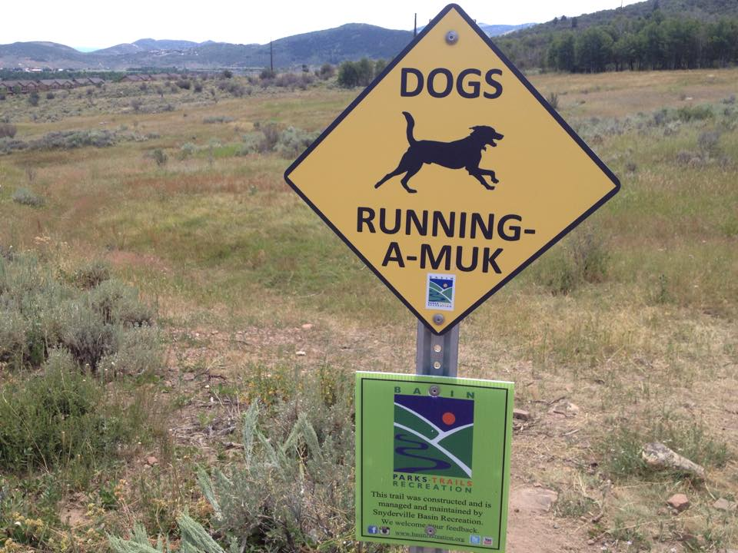
Special Service Districts
A primer for Administrative
Control Boards

Slide 2
Topics
SPECIAL SERVICE DISTRICTS
ROLE OF THE EXECUTIVE OFFICER AND ADMINISTRATIVE CONTROL BOARD
OPEN MEETINGS (FOR THOSE WHO MISSED THE COUNTY ATTORNEY ANNUAL TRAINING)
LIABILITY AND IMMUNITY

Slide 3





Special service districts
(Title 2, Summit County Code)
Mountain Regional Water (Chapter 9; created 1982)
North Summit Recreation (Chapter 11; created 2008)
Eastern Summit County Water Conservancy (Chapter 20; created 2008)
Snyderville Basin Recreation (Chapter 21; created 1986)
Peoa Recreation (Chapter 22; created 1998)
Park City Fire (Chapter 24; created 1984)
North Summit Fire (Chapter 25; created 1976)
Kimball Area Transportation (Chapter 31; created 2000)
Echo Creek Ranches (Chapter 33; created 1988)
Timberline (Chapter 38; created 1995)
Special Service District No. 1 (Chapter 39; created 1989)
Echo Sewer (Chapter 41; created 2012)
There are 13 independent local districts within the County; including the Snyderville Basin Water Reclamation District, South Summit Fire, and Service Area #3
* County run entity (No Administrative Control Board)

Slide 4

Special Service district facts
Services
Governance
Non-delegable Duties
Water
Sewer
Cemetery
Mineral Lease (roads)
Transportation
Recreation
Fire Protection
Animal Control
Garbage Collection/Disposal
Dependent District
County Council is governing body
Delegation of powers to:
  Administrative Control Board
  Executive Officer
Subject to Local District Act, UCA § 17D-1-106
Subject to Fiscal Procedures for Local Districts (Budget)
Subject to Local District Audit Reports (External Audit Report)
Subject to Local District Personnel Management (Merit System)
Subject to Collection of Service Fees and Charges (Public Hearing)
Subject to Utah Procurement Code
Annexation
Designate public works contracts subject to Title 11, Chapter 39 ($175K – bid and notice)
Property Taxation
General Obligation / Revenue Bonds
Assessments & Interim Warrants
Board of Equalization appointment (Assessment Area)

Slide 5


County Council Role
Council appoints and removes ACB Members
Council consents to the hire and discharge of the Executive Officer
Requires an ILA with County for legal services
Power to un-delegate powers from the ACB:
  Personnel (operates under a letter of authorization)
  Budget
  Bylaws, Policies, Procedures and Regulations
  Eminent Domain
  Real Property (Recreation Districts)
  Direct litigation (MRW)

Slide 6

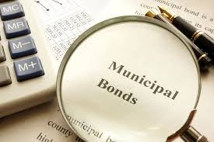

Funding and Financing
Fee for Service (UCA 17B-6-643) – public hearing required
Property Tax (UCA 17D-1-105) – election required; no rate limitation*
Sales Tax – Not Available to SSD
Impact Fees – UCA Title 11, Chapter 36
General Obligation Bond (election) – UCA Title 11, Chapter 14*
Lease-Revenue Bond (any bond over $10M requires a public hearing)*
* Requires the approval of the County Council. After voter approval for a property tax, Council conducts a Truth-in-Taxation hearing for the following year’s budget.

Slide 7

The executive officer
Supervisory Role
Financial Role
Asset Manager Role
Liaison Role
Regulatory Role

Slide 8
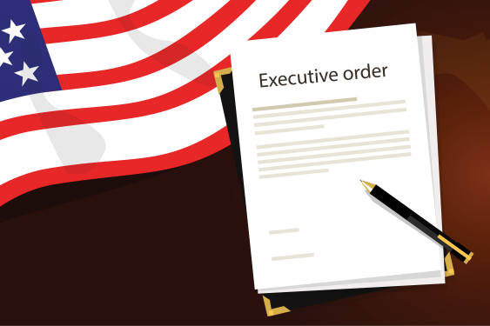
Supervisory Role
  Supervises Department Heads/ District Officers
  Approves all District personnel actions (with assistance from County Attorney)
  Controls and directs the prosecution, defense, and settlement of all civil lawsuits (with assistance of the County Attorney)
  Issues Executive Orders (County Attorney must approve as to form)
  Keeps the Board updated on all matters pertaining to the District

Slide 9

Financial Role
  Acts as the District’s Purchasing Agent (following the Utah Procurement Code)
  Executes contracts (County Attorney must approve as to form)
  Presents a proposed Budget to the Board
  Acts as the District’s Risk Manager (interfaces with the Utah Local Government’s Trust or other insurance)
  Applies for grants
  Approves all expenditures and warrants up to limits set by the Board’s procurement policy

Slide 10
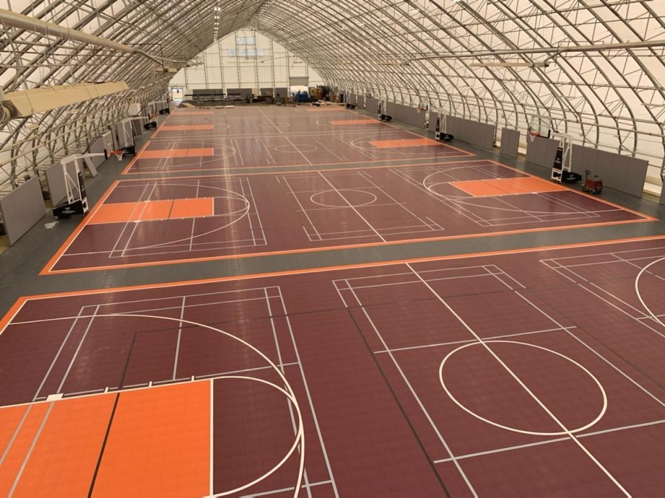
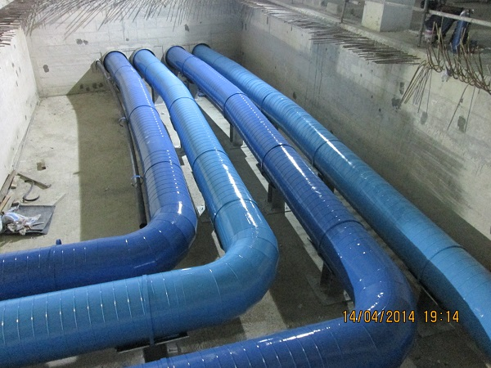
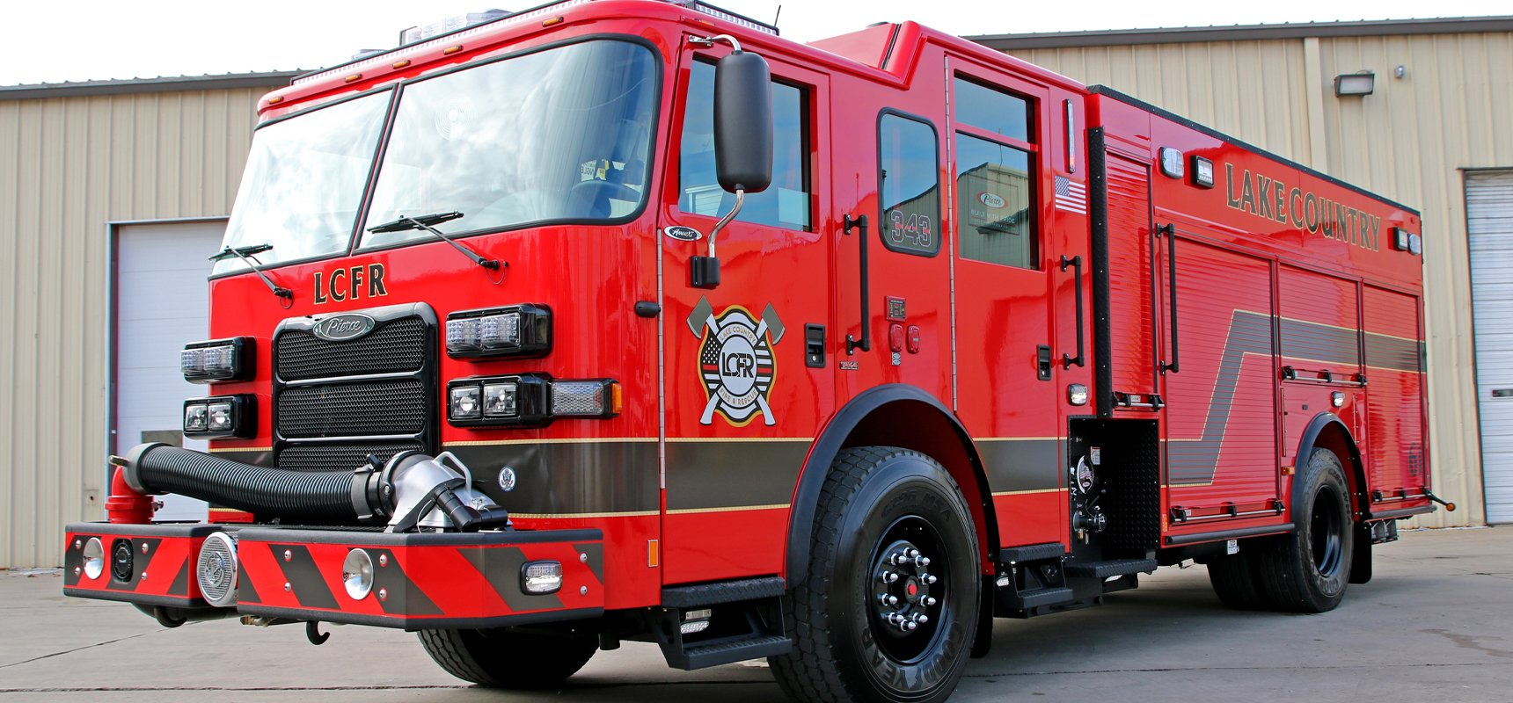
Asset Manager Role
  Approves construction and alteration of all District facilities
  Exercises control over all assets and real property
  Develops Capital Facilities Plan (which is approved by the Board and County Council) and Implements Plan
  Purchases and Disposes of all real* and personal property
* with the consent of the Board (and with respect to recreation districts, the consent of the County Council)

Slide 11
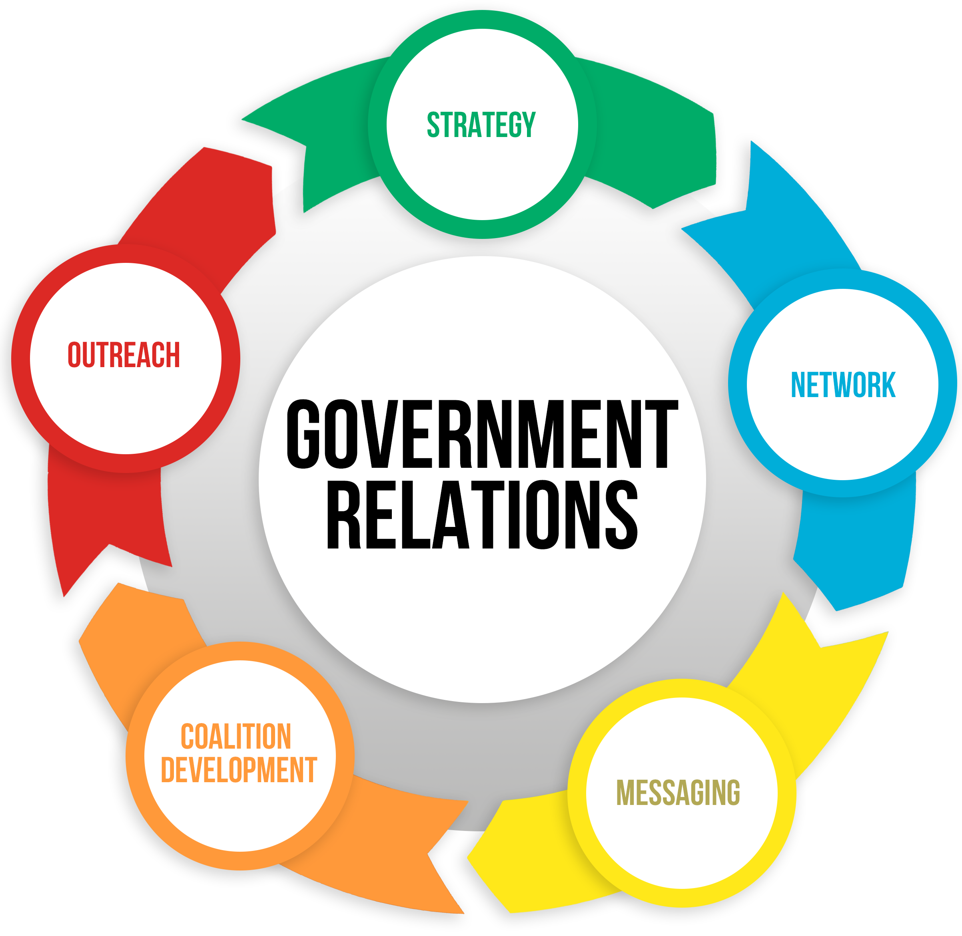
Liaison Role
  County Manager
  County Council
  County Attorney
  Intergovernmental Relations
    County
    Cities
    SSD
    Independent Local Districts
    School District
  Special Service District Association
  Acts as the Public Relations Officer (with assistance from the
  County’s PIO)

Slide 12




Regulatory Role
  Enforces compliance with all District rules, regulations, policies and procedures
  Subdivision plat approval (service provider sign-off)
  Custodian of Board minutes and actions (District Clerk)
  Prepares rules, regulations, policies and procedures for consideration by the Board
  Resolves complaints
  Prepares organization master plans
  Complies with GRAMA (appoints GRAMA Officer) and OPMA
  Renews registration with LTG annually

Slide 13

The administrative control board
Regulatory Role
Financial Role
Supervisory Role
Governing Body Role
**Utah State Auditor provides a “Little Manual for Local and Special Service Districts” as a resource

Slide 14


Regulatory Role
  Recommends bylaws, policies, procedures, and regulations to the County Council
  May sit in an appellate role to hear appeals as part of its Policies, Procedures, and Regulations*
  Recommends organization master plans to
  the County Council
  Attends annual OPMA training
* For example, bid protests

Slide 15




Financial Role
  Recommends annual District Budget to the County Council
  Recommends Capital Facilities Plan to the County Council
  Recommends Tax Levies to the County Council (Truth-in-Taxation Hearings before the Council)
  Conducts Financial and Performance Audits (Audit Committee)
  Exercises Financial oversight of the District
  Recommends Parameters Resolutions for Bonding to the County Council
  Imposes Impact Fees
  Sets District Fee Structure (through the budget process)
  Approves investment of funds (Money Management Act)

Slide 16
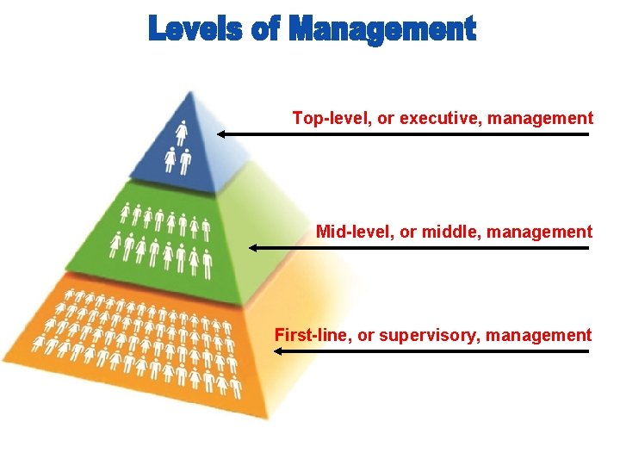
Supervisory Role
  Vetoes hiring decisions of the Executive Officer
  Vetoes Executive Orders of the Executive Officer
  Conducts Performance Evaluations of the Executive Officer (Board is the Executive Officer’s boss)
  Appoints and Discharges the Executive Officer with the advice and consent of the County Council
  May serve as the appellate body on personnel actions (Career Service Council)
  Does not direct individual employees of the District, but acts through the Executive Officer

Slide 17

Governing Body Role
  Acts as the principal policy maker for the District
  Acts in an oversight capacity over all matters pertaining to the District
  The will of the Board shall be expressed by a majority vote of a quorum of the Board. No statement or act of any individual member of the Board shall be viewed as the will of the Board.

Slide 18
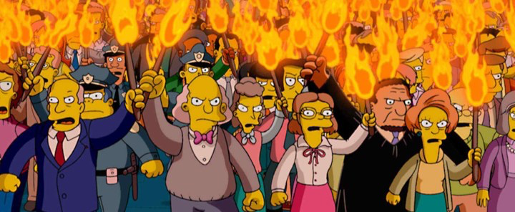
Utah Open and Public Meetings Act (“OPMA”)
Utah Code §§ 52-4-101 et seq.
``````````````````````````````````````````

Slide 19
Open Meetings Act
Statement of Public Policy
We* “exist to aid in the conduct of the people’s business.”
We conduct deliberations openly.
We take our actions openly.
Utah Code § 52-4-102
“We” = Public Bodies = an administrative, advisory, executive, or legislative body of the state or its political subdivisions that consists of two or more persons, expends, distributes or is supported by tax revenue and is vested with authority to make decisions regarding the public’s business.
Utah Code § 52-4-103(7)

Slide 20
OPMA (and this Presentation)
Covers These Topics
Notice
Location
Conduct of Meetings (Open and Closed)
Emergencies
Recordkeeping
Enforcement

Slide 21
Notice
At minimum, 24 hours in advance
Must include an Agenda
Must list Date, Time, and Place of meeting
Utah Code § 52-4-202

Slide 22
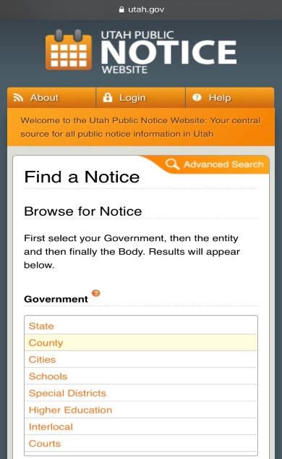
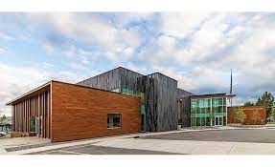
Where to Post Notice?
The Utah Public Notice Website utah.gov
The district’s official website
and in a public location within the district that is reasonably likely to be seen by residents of the district
AND
Utah Code § 63G-30-102(1)

Slide 23
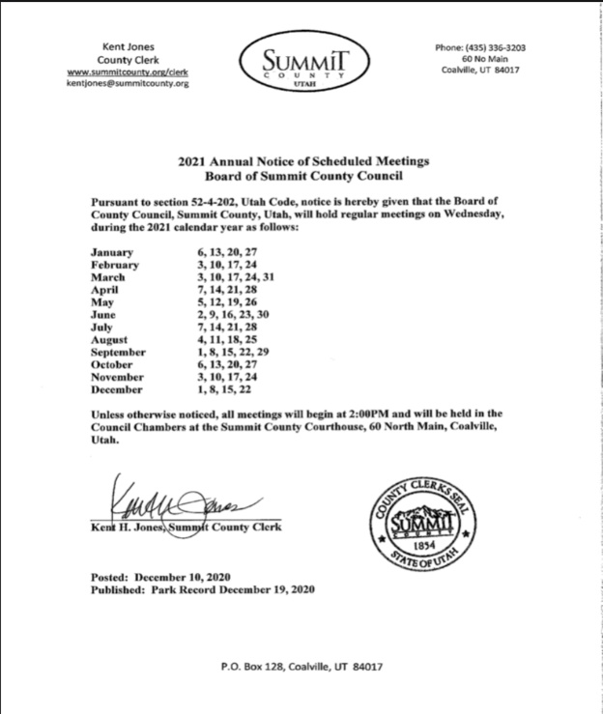
Publish an Annual Meeting Schedule
Required for Public Bodies that Hold Regular Meetings
Publish in the Same Manner as for Meetings
Utah Code § 52-4-202(2)

Slide 24
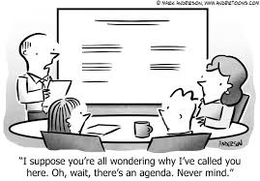
Your Notice Must Include An Agenda
Content:
Date
Time
Place (And/Or Electronic Instructions)
Agenda
“Reasonable Specificity” to notify the public as to topics to be considered at the meeting
Utah Code § 52-4-202(6)(a)

Slide 25

Final action in an open meeting
A public body may not take final action on a topic in an open meeting unless:
-the topic is listed under an agenda item and
-included with the required advanced public notice
(Except in the case of emergency meetings)
Utah Code § 52-4-202

Slide 26


What if the public raises a topic that is not on the agenda?
At the discretion of the chair, a topic raised by the public may be discussed during an open meeting, even if the topic raised by the public was not included in the agenda or advanced public notice for the meeting.
But no vote may be taken on that topic
Utah Code Ann. § 52-4-202(6)b)

Slide 27
Reasonable Specificity
“review old business”
“discuss constituent concerns”
“review and possible decision on 2021 proposed sport changes for the North Summit Recreation District: football, basketball, soccer, and baseball”
hyperlink your agenda where possible so the public can find staff reports, web pages, or other materials relevant to the agenda item

Slide 28
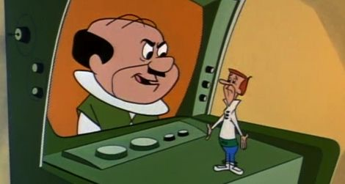
“A public body may conduct a meeting that some or all members of the public body attend through an electronic video, audio, or both video and audio connection”
Utah Code § 52-4-207
Must first pass a resolution, rule, or ordinance governing use of electronic meetings, which includes the conditions under which a remote member is included in calculating a quorum.
Must establish an Anchor Location.
May dispense with Anchor Location if:
  conducting the meeting at an Anchor Location presents a substantial risk to the health or safety of those present or who would otherwise be present at the Anchor Location; or
  the location where the public body would normally meet has been ordered closed to the public for health or safety reasons.
  Additional notice requirements apply.
”Participate” means the ability to communicate with all the members of a public body either verbally or electronically, so that each member of the public body can hear or observe the communication.
Utah Code § 52-4-103(8)

Slide 29
Conduct of Meetings: All meetings are presumptively open and public
“Meeting” means a gathering of a public body with a quorum present; and
that is convened:
by an individual (the Chair):
(A) with authority to convene the public body or specified body; and
(B) following the process provided by law for convening the public body or specified body; and
for the express purpose of acting as a public body or specified body to:
(A) receive public comment about a relevant matter;
(B) deliberate about a relevant matter; or
(C) take action upon a relevant matter.
Utah Code § 52-4-103(6)

Slide 30

Some types of Meetings that must be noticed:
Traditional Meetings
Workshops
Executive Session (unless closed per statute)
Site Visits
Traveling Tours
Utah Code § 52-4-201

Slide 31
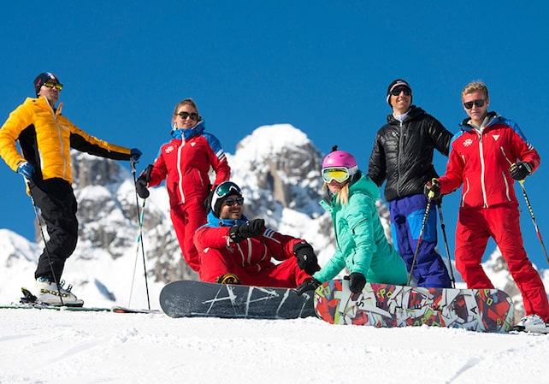
NOT A Meeting BUT…
Individuals constituting a quorum
of a public body may not act together outside a meeting
in a concerted and deliberate way to predetermine an action
to be taken by the public body at a meeting on a relevant matter.
Utah Code § 52-4-208(1)

Slide 32
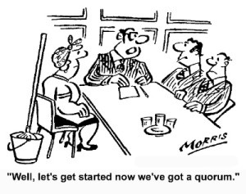
What is a Quorum?
“Quorum” means a simple majority of the membership of a public body
Utah Code § 52-4-103(11)

Slide 33
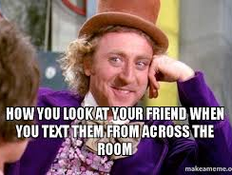
“Discussing” During a Meeting
Zoom Chat – No
Group or Individual Text Comments to One Another – No
Email Deliberations – No
Say it so everyone can hear it

Slide 34

EMAILS AND TEXTS
It’s okay to forward pertinent information to one another BUT . . .
Information dissemination is different from discussion.
DO NOT REPLY ALL.
Common Sense: It’s okay to maintain group comradery by sharing jokes, baby rhino videos, inoffensive memes that are not related to the public business

Slide 35

Emergency Meetings
An emergency meeting may be held IF:
because of unforeseen circumstances it is necessary for a public body or specified body to hold an emergency meeting to consider matters of an emergency or urgent nature;
and
the public body gives the best notice practicable of:
  the time and place of the emergency meeting; and
  the topics to be considered at the emergency meeting.
Utah Code § 52-4-202(5)(a)
*An attempt must be made to notify all the members of the public body; and
a majority of the members of the public body must approve of the meeting

Slide 36
How to Close a Meeting
You May Notice a Closed Meeting in Advance
OR
Or
You may go into a Closed Meeting from an Open Meeting,
by, while in the open meeting:
taking a vote by name to close the meeting,
stating the reason for closing, and
the location where the closed meeting will be held
Utah Code § 52-4-204

Slide 37

Procedure for Closing
1. A quorum must be present.
2. A motion to close the meeting must be made, naming the specific statutory reason for closure.
3. A roll call vote must be taken.
4. Two-thirds of the body must approve the closed meeting.
5. Observe appropriate Recordkeeping, recording, and affidavits.
6. A motion to adjourn or return to the Open Meeting must be made, with roll call vote.

Slide 38
Quick Reference Guide for
Closed Meetings
Reason | Description | Recording? | Affidavit ?
Litigation | Strategy session to discuss pending or reasonably imminent litigation. | Yes | No
Personnel | Discussion of the character, professional competence, or physical or mental health of an individual. | No | Yes
Property Acquisition | Strategy session to discuss the purchase, exchange, or lease of real property. | Yes | No
Security | Discussion regarding deployment of security personnel, devices, or systems. | No | Yes
Utah Code § 52-4-205(1)

Slide 39
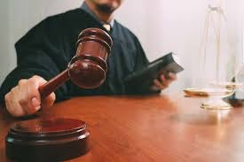
Recordings of
Closed Meetings are
Protected Records Under GRAMA
May be later disclosed by court order if challenged
Utah Code 52-4-206(4)

Slide 40

What is Forbidden During a
Closed Meeting?
You May Not:
Approve an ordinance, resolution, rule, regulation, contract or appointment
Interview a person to fill an elected position
Take final action: Final votes must be open and on the record
Allow the Closed Meeting to sway off statutorily authorized topic

Slide 41
Are there any Meetings that must be closed?
NO!
The decision to close a meeting to the public is always discretionary
The law does not require any meeting to be closed

Slide 42
Records of Open Meetings
Utah Code §§ 52-4-203
Written minutes of an open meeting shall include:
the date, time, and place of the meeting;
the names of members present and absent;
the substance of all matters proposed, discussed, or decided by the public body which may include a summary of comments made by members of the public body;
a record, by individual member, of each vote taken by the public body;
the name of every member of the public who provided testimony or comments to the public body and the substance of the comments provided.
if an individual publicly presents or provides electronic information, relating to an item on the public body's meeting agenda, the individual must provide the public body, at the time of the meeting, an electronic or hard copy of the electronic information for inclusion in the public record.
any other information that is a record of the proceedings of the meeting that any member requests be entered in the minutes or recording.
A recording is not required to be kept of an open meeting that is a site visit or a traveling tour, if no vote or action is taken by the public body
Utah Code § 52-4-203

Slide 43
RECORDS OF CLOSED MEETINGS
A public body
Shall record the closed portion of the meeting; and
may keep detailed written minutes that disclose the content of the closed portion of the meeting.
The recording and any minutes of a closed meeting shall include:
- the date, time, and place of the meeting;
- the names of members present and absent; and
- the names of all others present except where the disclosure would infringe on the confidentiality necessary to fulfill the original purpose of closing the meeting.
If a public body closes a meeting to discuss the character, professional competence, or physical or mental health of an individual; or to discuss deployment of security personnel, devices, or systems;
then no recording is necessary,
but the person presiding must sign a sworn statement affirming that the sole purpose for closing the meeting was to discuss one of those two purposes.
Copy and paste this link into your browser for a copy of a blank affidavit:
https://acrobat.adobe.com/id/urn:aaid:sc:VA6C2:cdd2611c-d184-46bf-a085-ec86412a8808
Utah Code Ann. § 52-4-203

Slide 44

E n f o r c e m e n t
County Attorney and Attorney General
Any party denied a right by the action taken
Court may order compliance and enjoin violation
Aggrieved party may recover attorneys’ fees
Utah Code § 52-4-303

Slide 45
Non-Criminal Remedies:
Any final action taken in violation of Open Meetings, Notice Requirements, Emergency Meeting Provisions, or Electronic Meeting Requirements, is voidable by a court of competent jurisdiction
Sometimes a violation can be cured by discussing and taking a public vote in a subsequent meeting
A suit to void final action shall be commenced within 90 days after the date of the action (unless the alleged violation involved bonds, notes, or other evidences of indebtedness, then the Complaint must be filed within 30 days)
The Public Body may still have to pay litigation costs and attorneys fees
Voiding Final Action

Slide 46

Intentionally Violating Open Meetings Provisions: What Can Happen?
In addition to any non-criminal penalty,
a member of a public body who knowingly or intentionally violates or who knowingly or intentionally abets or advises in violation of the Closed Meeting provisions is guilty of a Class B misdemeanor (6 months jail and/or $1000 fine)
Utah Code § 52-4-305

Slide 47

Training
The presiding officer of a public body shall ensure that the body receives OPMA training on an annual basis
Utah Code § 52-4-104

Slide 48
Common Violations of OPMA
Closing meeting without members of the public body voting first in an open meeting to close the meeting
Conducting a closed meeting for reasons other than those allowed by OPMA
Taking official or final action in a closed meeting
Failing to properly provide notice of a public meeting (notice or reasonable specificity)
Although not a specific violation of the Act, it is a potential “due process” violation to allow public comment on a pending application where the applicant has not been given prior notice

Slide 49

Parting Tips and Helpful Suggestions
Provide 24-hour notice
Be specific with agenda items
No ‘old business’ and ‘new business’
“Action taken on items discussed in closed meeting” is not enough
Close meetings only for allowed statutory purposes and follow the process
Don’t text each other during meetings
Don’t have "meetings” outside of the noticed meetings
Err on the side of transparency
When in doubt, consult your local friendly deputy county attorneys or the County Attorney at the Summit County Attorney’s Office

Slide 50
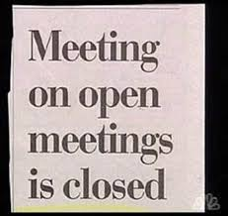
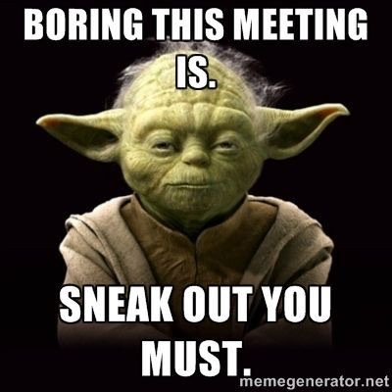
Please certify to your Chair that you attended this training.

Slide 51
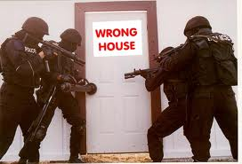
Liability and Immunity

Slide 52

Absolute Immunity
Legislative actions have “absolute immunity”
Legislative acts are not limited to the County Council. Other bodies may be engaged in “legislative-type” actions.
Bogan v. Scott-Harris, 523 U.S. 44 (1998).
  “[T]he exercise of legislative discretion should not be inhibited by judicial interference or distorted by the fear of personal liability.”
  “[T]he time and energy required to defend against a lawsuit are of particular concern at the local level, where the part-time citizen-legislator remains commonplace [a]nd the threat of liability may significantly deter service in local government, where prestige and pecuniary rewards may pale in comparison to the threat of civil liability.”
However, this doesn’t provide protection from an injunction and related attorney fees. Pulliam v. Allen, 104 S.Ct. 1970, 1981 (1984).

Slide 53

Qualified Immunity
Applies to administrative decisions and actions
Anderson v. Creighton, 107 S.Ct. 3034, 3039 (1987)
  Qualified immunity is an affirmative defense that, when asserted, requires the plaintiff to show that the official violated a “clearly established” right. “The contours of the right must be sufficiently clear that a reasonable official would understand that what he is doing violates that right.”
Common law granted public officials qualified immunity if they were engaged in an exercise of discretion and if there was no willful wrongdoing. Synder v. Merkley, 693 P.2d 64 (Utah 1987).
“[G]overnment officials performing discretionary functions, generally are shielded from liability for civil damages insofar as their conduct does not violate clearly established statutory or constitutional rights of which a reasonable person would have known.” Harlow v. Fitzgerald, 457 U.S. 800, 818 (1982).

Slide 54

Accessing Qualified Immunity
Good-faith reliance on legal
advice (Safe Harbor Rule)
Interpretation:
STAY IN YOUR OWN LANE
(operate within the guardrails set by your attorney)
  Los Angles Police Protective League v. Gates, 907 F.2d 879
  (9th Cir. 1990); Shank v. Neas, 773 F.2d 1121 (10th Cir. 1985)

Slide 55


Legislative v. Administrative decisions
Primary Question:
Is the action creating policy or is it applying the law as it exists?
Creating = legislative
Applying = administrative
See Harmon City v. Draper, 2000 Ut App 31 ¶17, 18

Slide 56
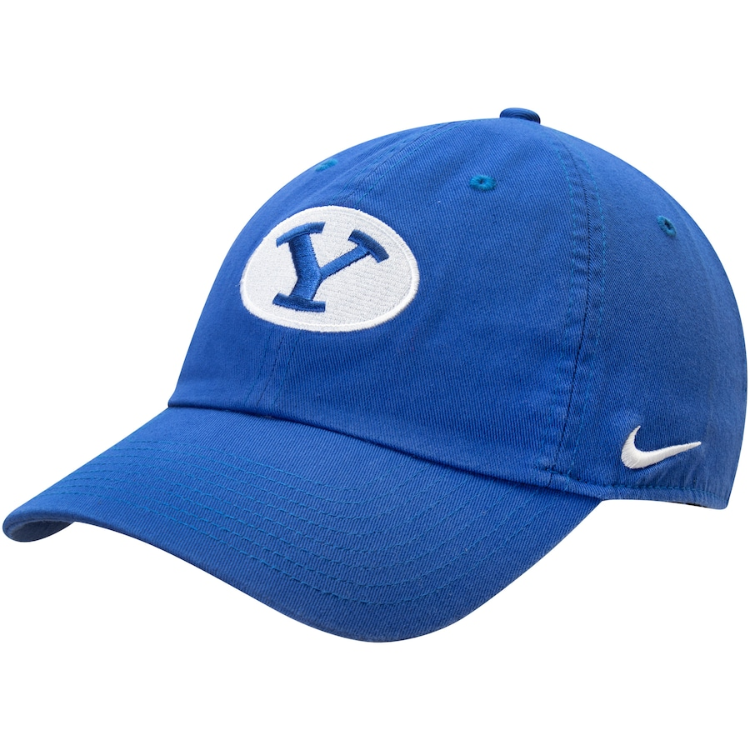

Knowing which hat you are wearing is important
Legislative (Absolute Immunity)
Administrative (Qualified Immunity)
Approving a budget
Enacting district wide policies
Making laws and regulations
Levying a tax
Applying the law or regulation to a specific property or person
Ministerial acts (negotiating a contract)
Buying and selling property
Personnel decisions

Slide 57

When do you have the right to use the district’s liability insurance?
    UCA 63G-7-902 (Government shall defend and indemnify any action brought against an employee acting within the scope of employment or under color of law so long as there is not fraud or willful misconduct (malice))

Slide 58
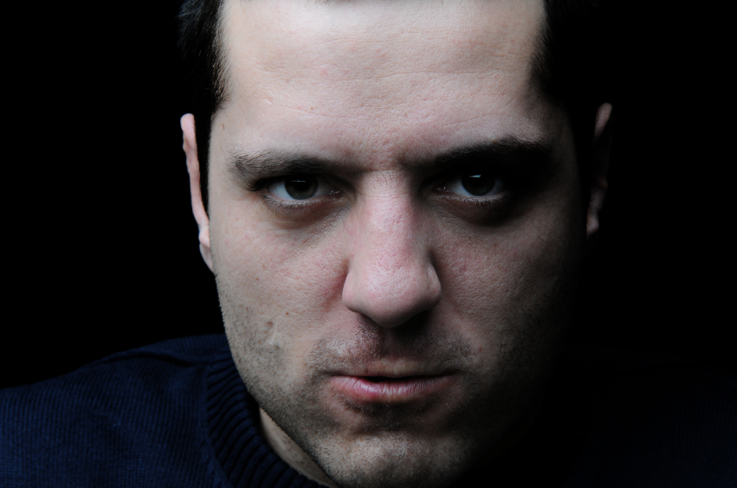
What is “Malice?”
    “Malice is the committing of a[] wrongful act with the intent to inflict injury or under circumstances where the law will imply evil intent.” Black’s Law Dictionary, 5ed. (1979).

Slide 59
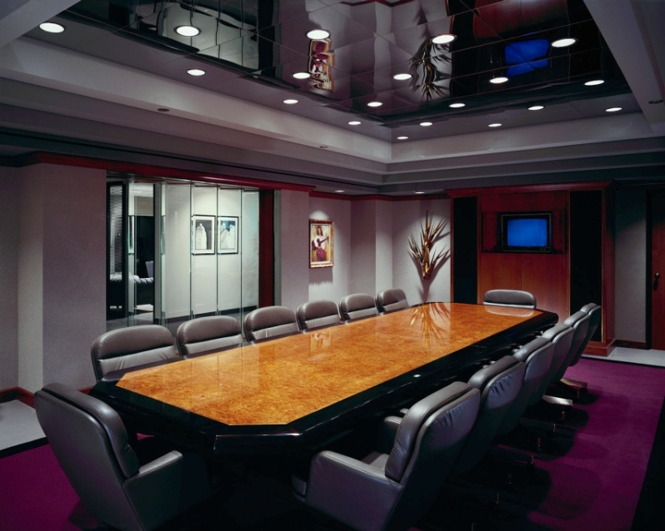
Open Meetings Act violations
Ensure that you are in compliance with the open meetings law – an intentional violation done where injury to someone is a foreseeable result, may amount to “malice” and is outside the scope of employment or office. It may also raise concerns over “due process of law.”
Utah Land Use Institute, “Utah Land Use Law Seminars” (March 2010).

Slide 60
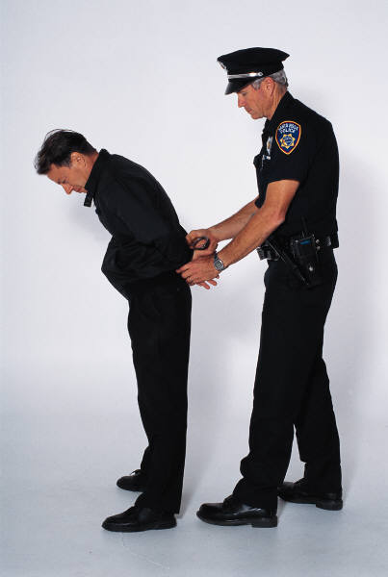
Willfully Violating the Law
Where a law is “clearly established” and you intentionally violate it, not only do you lose your “qualified immunity,” but it may also be viewed as “malice” if the result of your action is to intentionally injure.
This is why the Safe Harbor rule was made

Slide 61
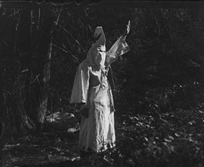
42 USC 1983 (Civil Rights Violation)
The Ku Klux Klan Act of 1871
  Violation where a person acting under color of state law deprives another of rights secured by the US Constitution or federal law (i.e.; discrimination)
  Utah Governmental Immunity Act is not a defense
  If a public official has evil motive or intent, is reckless or has a callous disregard of or
  indifference to the rights of others, punitive damages may be awarded.
  Nieto v. Kapoor, 268 F.3d 1208 (10th Cir. 2001)

Slide 62

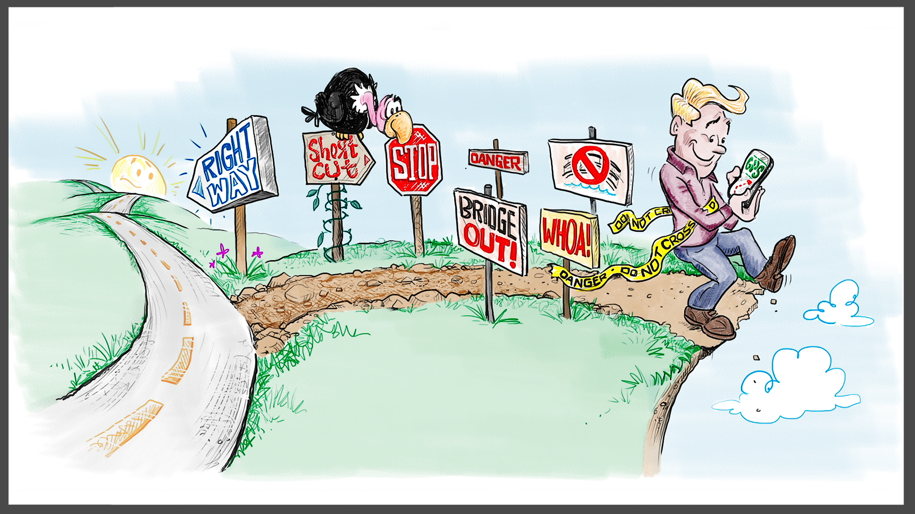
Conflicts of Interest:
  Monetary or familial relationship – disclose and recuse from decision-making
  Other conflicts – disclose
No solicitation or acceptance of gifts, compensation or loans that may influence your Board decision
Can accept non-cash gift with a value of $50 or less
No nepotism (no direct supervision of relatives)
Board members cannot be employees of the District
Must fill out (or update) Disclosure annually and affix to website

